Slide 1

Vellore Institute OF Technology, BHOPAL
Fundamentals In AI & ML
(Department of Computer Science & Engineering)
Sonam Goswami
Vellore Institute Of Technology (VIT), Bhopal, India

Slide 2
Module-4 Software Agents and Prolog

Slide 3
Architecture for Intelligent Agents:
The task of AI is to design an agent program which implements the agent function. The structure of an intelligent agent is a combination of architecture and agent program. It can be viewed as:
Agent = Architecture + Agent Program
Following are the main three terms involved in the structure of an AI agent:
Architecture: Architecture is the machinery on which the agent executes its action. It is essentially a device with embedded actuators and sensors.

Slide 4
Agent Program: The Agent Program performs the execution of the Agent Function. The execution happens on top of Agent Architecture and produces the desired function.
Agent Function: This is a function in which actions are mapped from a certain percept sequence. Percept sequence refers to a history of what the intelligent agent has perceived.
f . P *-> A

Slide 5
PEAS Representation:
PEAS stands for:
– Performance
– Environment
– Actuators
– Sensors
Performance Measure: The output which we get from the agent. All the necessary results that an agent gives after processing comes under its performance.

Slide 6
Environment: All the surrounding things and conditions of an agent fall in this section. It basically consists of all the things under which the agents work.
Actuators: The devices, hardware or software through which the agent performs any actions or processes any information to produce a result are the actuators of the agent.
Sensors: The devices through which the agent observes and perceives its environment are the sensors of the agent.

Slide 7
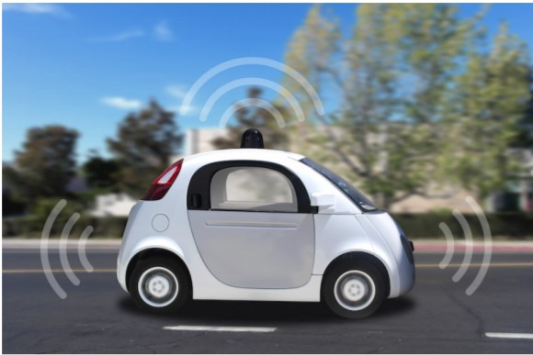
What is PEAS for Self-driving Cars:
Performance: Safety, time, legal drive, comfort.
Environment: Roads, other cars, pedestrians, road signs.
Actuators: Steering, accelerator, brake, signal, horn.
Sensors: Camera, sonar, GPS, Speedometer, odometer, accelerometer, engine sensors, keyboard.

Slide 8
Agent Communication:
Communication is necessary in order to allow collaboration, negotiation, cooperation, etc… between independent entities. For this purpose, it requires a well-defined, agreed and commonly understood semantics.
Agent is an active object with the ability to perceive, reason and act.
Agent has the ability to communicate. This ability is part perceptron (the receiving of messages) and part action (the sending of messages).
Communication can enable the agents to coordinate their actions and behaviour, resulting in systems that are more coherent.

Slide 9
Why do we need Agent Communication:
To have a interaction between a machine and a human we need agent communication.

Slide 10
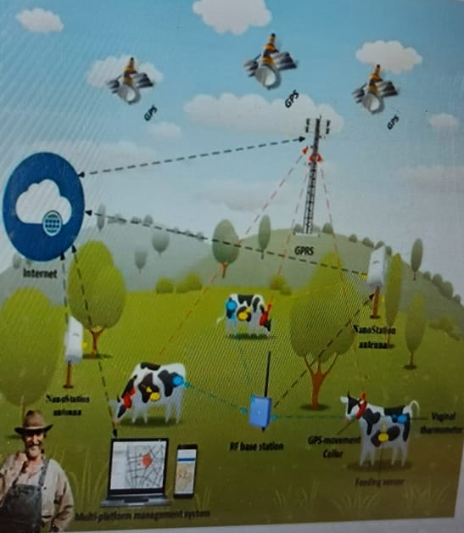
Multi-agent System:
Computerized system composed of multiple interacting intelligent agents.
Examples:
Robots, humans or human teams.
Contain combined human-agent teams
Distributed systems

Slide 11
Collaborative Agents:
A multi-agent system (MAS) may be seen as a collection of collaborative agents.
They can communicate and cooperate with other agents, while keeping their autonomy.
They usually negotiate with their peers to reach mutually acceptable agreements during cooperative problem solving.
They have limited learning capabilities.

Slide 12
Collaborative Agents: Applications
Provide solutions to physically distributed problems
Disaster in a city (police, firemen, ambulances)
Provide solutions to problems with distributed data sources
Sensor network monitoring a given area
Provide solutions that need distributed expertise
Health care provision (family doctors, nurses, specialists, laboratory analysis).

Slide 13
Negotiation and Bargaining:
Negotiation:
Negotiation is a process in which a joint decision is made by two or more parties. The parties first verbalize contradictory demands and then move towards agreement by a process of concession-making or search for new alternatives.
The major features of Negotiation are
The language used by the participating agents.
The protocol followed by the agents as they negotiate.
The decision process that each agent uses to determine its positions, concessions and criteria for agreement.

Slide 14
Systems and Techniques for Negotiation:
Environment-centred
Agent-centered
The resultant negotiation mechanism should ideally have the following attributes:
Efficiency: The agents should not waste resources in coming to an agreement.
Stability: No agent should have an incentive to deviate from agreed-upon strategies.
Simplicity: The negotiation mechanism should impose low computational and bandwidth demands on the agents.

Slide 15
Distribution: The mechanism should not require a central decision maker.
Symmetry: The mechanism should not be biased against any agent for arbitrary or inappropriate reasons.

Slide 16
Types of Environment:
Worth-oriented domains
State-oriented domains
Task-oriented domains
A task-oriented domain is one where agents have a set of tasks to achieve, all resources needed to achieve the tasks are available, and the agents can achieve the tasks without help or interference from each other.
However, the agents can benefit by sharing some of the tasks.

Slide 17
Example: Internet downloading domain
Each agent is given a list of documents that it must access over the Internet.

Slide 18
Bargaining:
Bargaining is a simple form of the distributive negotiation process that is both competitive and positional. Meaning bargaining doesn’t seek to create value but instead focuses on negotiators claiming value.
Bargaining predominates in one-time negotiations, e.g. buying or selling a car or house when you don’t intend on having an ongoing relationship. One side usually attempts to gain an advantage over another to obtain the best possible agreement.

Slide 19
Cooperative game or Non-cooperative game:
There are two ways to model bilateral negotiations: using cooperative game or non-cooperative game.
In cooperative games, agreements are enforceable or binding, and its possible for the agents to negotiate outcomes that are mutually beneficial.
In non-cooperative game, the agents are self-Interested and thus they have incentive to deviate from an agreement to improve his/her utility.
Thus, a same game would have the different outcome between cooperative games and non-cooperative games.

Slide 20
Example:
Agents can cooperatively find the mutually most beneficial outcome.
 | Silent | Confess
Silent | 8,8 | 0,10
Confess | 10,0 | 5,5

Slide 21
Augmentation among agents:
“A verbal and social activity of reason aimed at increasing (or decreasing) the acceptability of a controversial standpoint for the listener or reader, by putting forward a constellation of propositions (i.e. arguments) intended to justify (or refute) the standpoint before a rational judge”.
Argument: Reasons / Justifications supporting a conclusion.
Represented as: support-> conclusion

Slide 22
Informational arguments: Beliefs-> Belief
e.g. If it is cloudy, it might rain.
Motivational arguments: Beliefs, Desires-> Desire
e.g. If it is cloudy and you own a raincoat then put the raincoat.
Practical arguments: Belief, Sub-Goals-> Goal
e.g. If it is cloudy and you own a raincoat then put the raincoat.
Social arguments: Social commitments-> Goal, Desire
e.g. I will stop at the corner because the law say so.
e.g. I can’t do that, I promise to my mother that won’t.

Slide 23
Cut and Fail Predicate:
Fail Predicate-
Fail predicate simply fails the rule.
The fail forces backtracking in an attempt to unify with another clause.
// Code snippet
a(x):- b(x), c(x), fail.
a(x):- d(x).
b(1).
b(4).
c(1).
c(3).
d(4). Query: ?- a(x).

Slide 24
Cut predicate-
Cut Predicate remove alternatives then forbids values that otherwise would be ‘returned’ by means of X binding.
Cut Predicate always succeeds.
Fail predicate always fail.
Symbol of cut predicate is “!”
//code snippet
a(x):- b(x), ! c(x).
a(x):- d(x).
b(1).
b(4).
c(1).
c(3).
d(4).

Slide 25
Difference Between Cut and Fail Predicate:
a(x):- b(x),!, c(x), fail. a(x):- d(x). b(1). b(4). c(1). c(3). d(4). Query: ? – a(x). FALSE | a(x):- b(x), c(x), fail, !. a(x):- d(x). b(1). b(4). c(1). c(3). d(4). Query: ?- a(x). X = 4

Slide 26
Thank you

